Slide 1
LHC and Search for Higgs Boson
Farhang Amiri
Physics Department
Weber State University

Slide 2
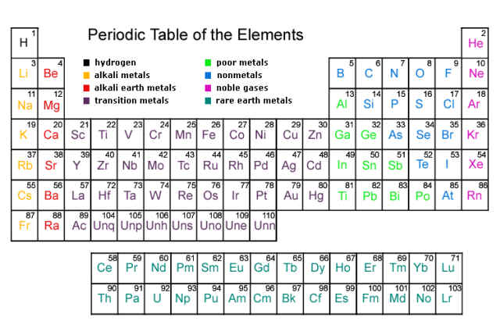
Atoms
This arises because atoms have substructure

Slide 3
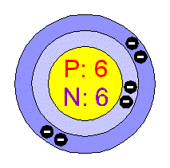
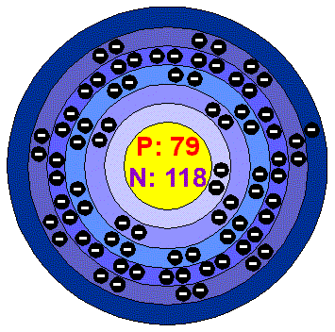
Inside Atoms: neutrons, protons, electrons
Carbon (C )
Atomic number Z=6 (number of protons)
Mass number A=12 (number of protons + neutrons)
# electrons = # protons (count them!) (atom is electrically neutral)
Gold (Au)
Atomic number Z = 79
Mass number A = 197
#electrons = # protons (trust me!)

Slide 4
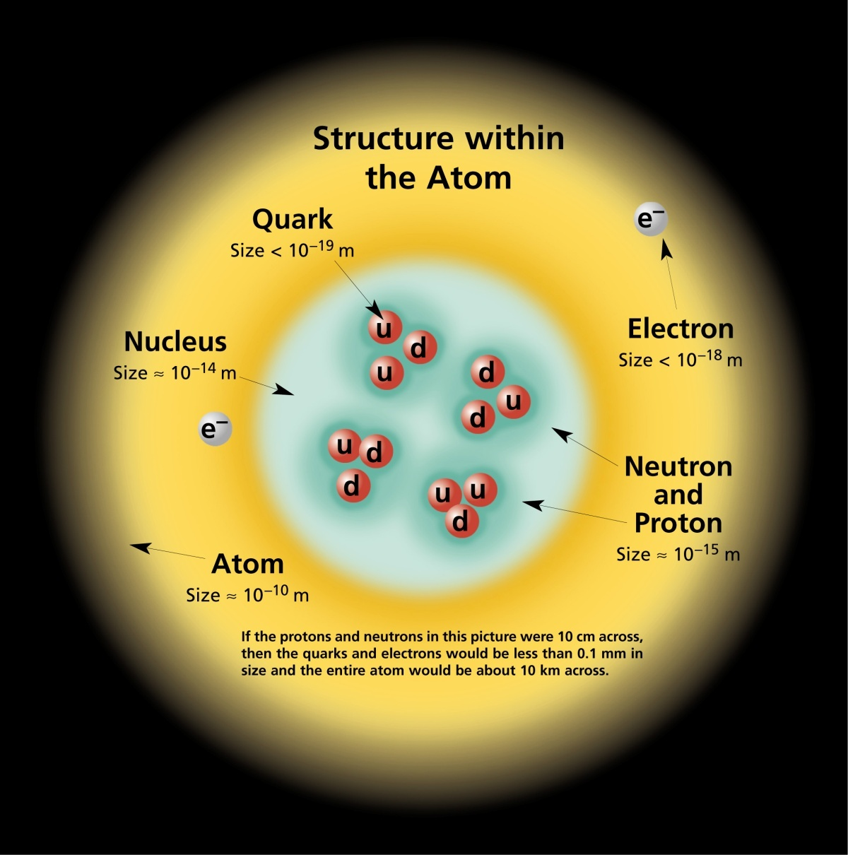
Further layers of substructure:
u quark: electric charge = 2/3
d quark: electric charge = -1/3
Proton = uud electric charge = 1
Neutron = udd electric charge = 0

Slide 5
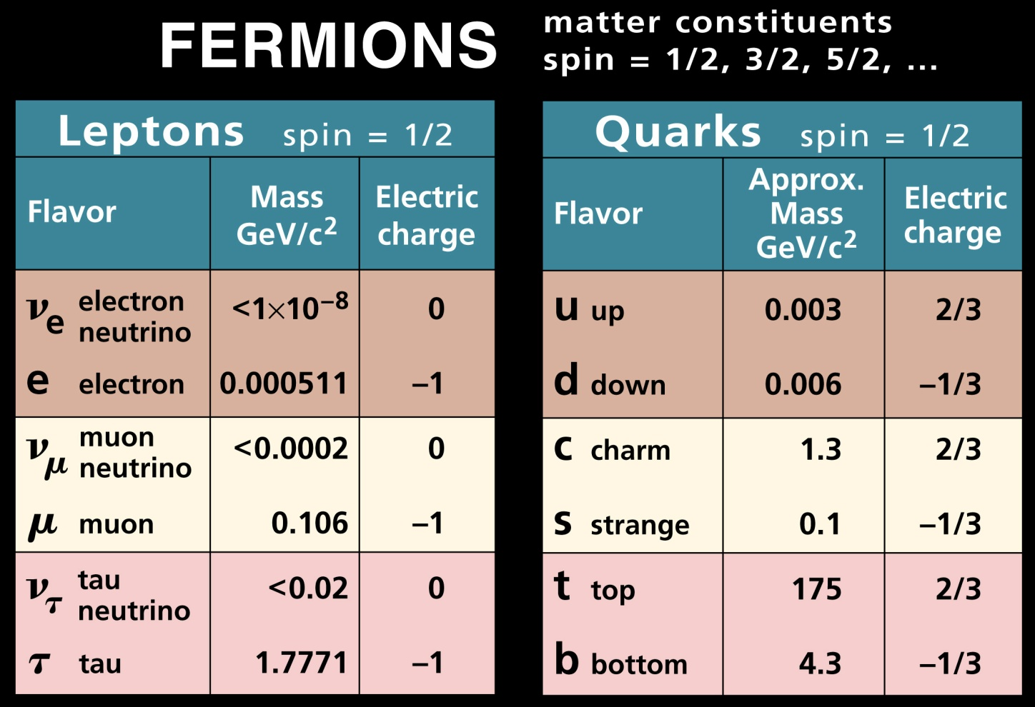
Fundamental Particles

Slide 6
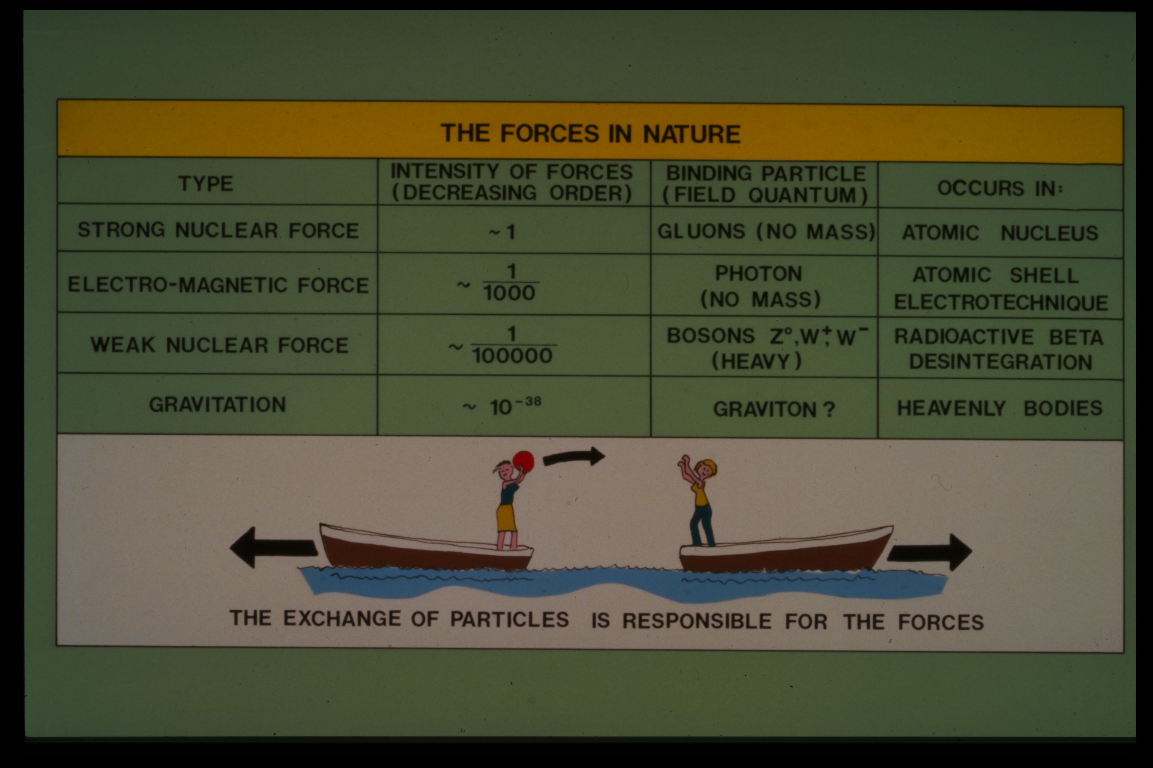
Force | Strength | Carrier | Physical effect
Strong nuclear | 1 | Gluons | Binds nuclei
Electromagnetic | .001 | Photon | Light, electricity
Weak nuclear | .00001 | Z⁰,W⁺,W⁻ | Radioactivity
Gravity | 10⁻³⁸ | Graviton? | Gravitation

Slide 7
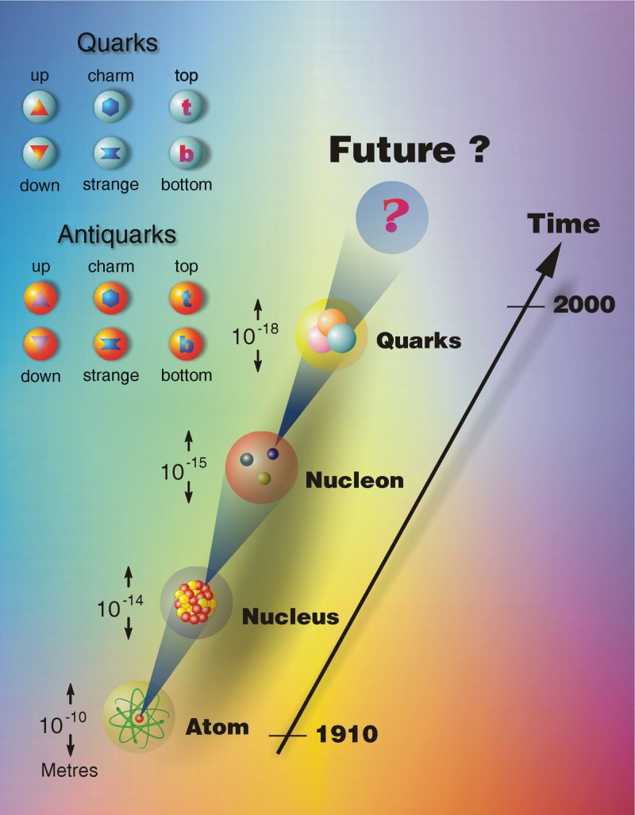

Slide 8
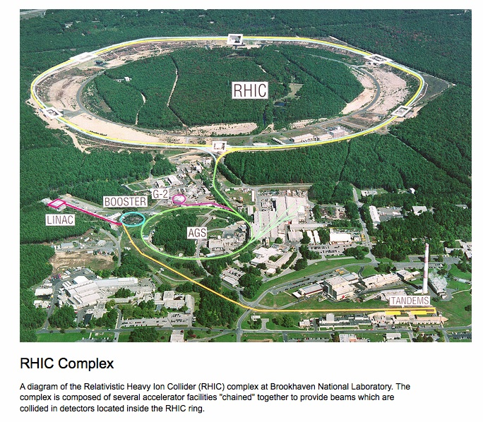

Slide 9
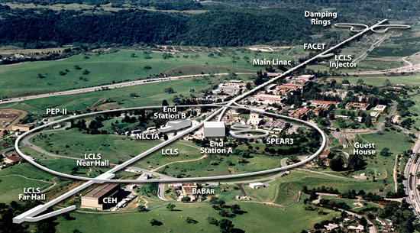

Slide 10
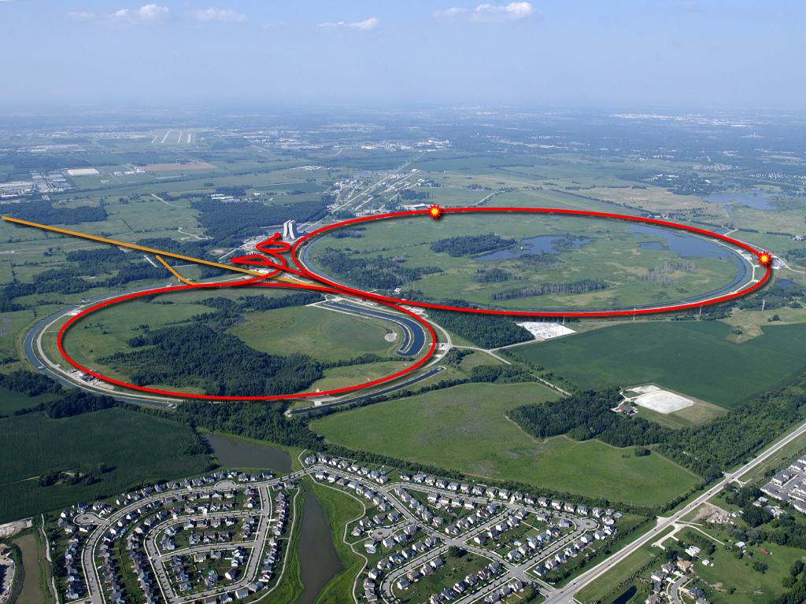
The Intensity Frontier
17 kW at 8 GeV
for neutrinos
Soudan
MiniBooNE
SciBooNE
MINOS
Tevatron Collider
250 kW at 120 GeV
for neutrinos
10
Young-Kee Kim: Ten Year Plan (Science and Resources), PAC Meeting 2009-03-05

Slide 11
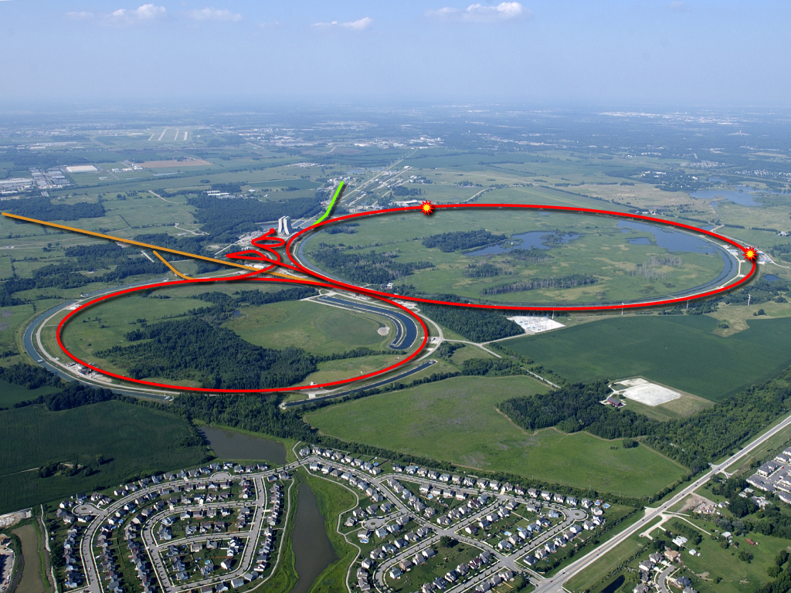

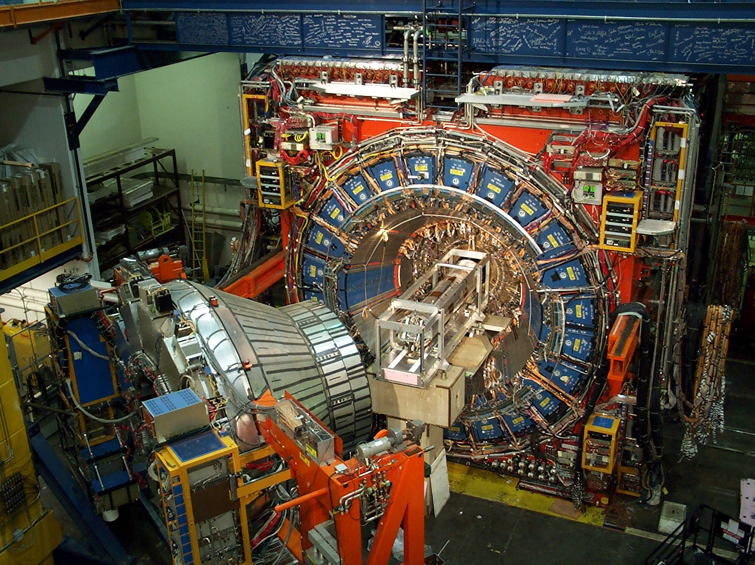
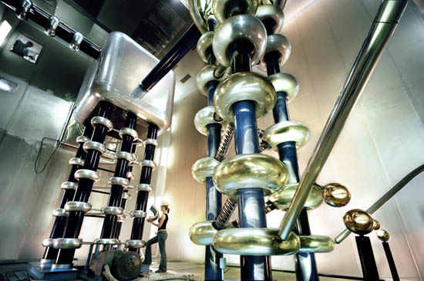
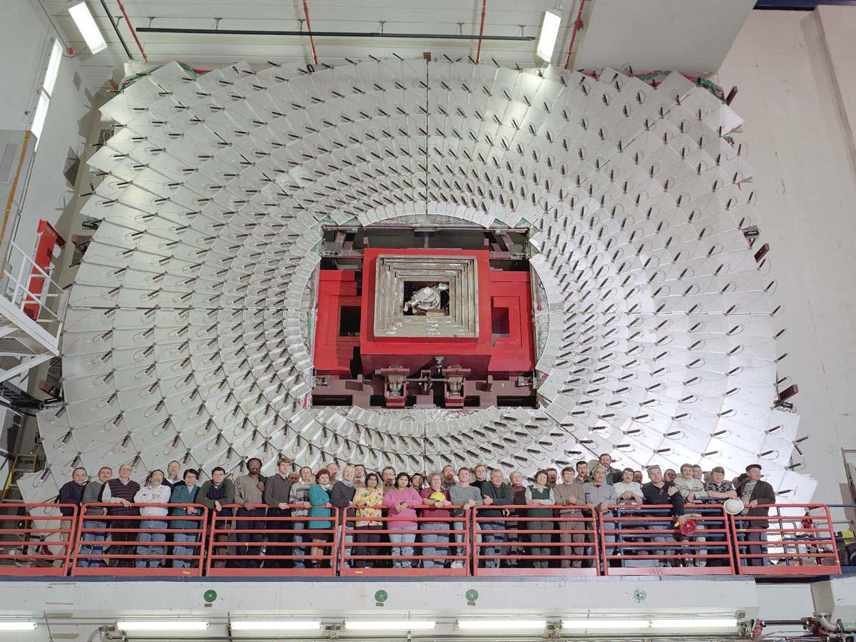
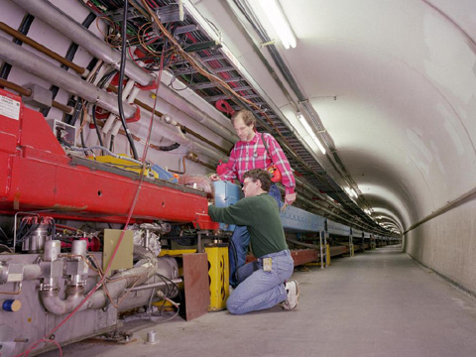
Accelerators – powerful tools for particle physics
CDF Experiment
We make high energy particle interactions
by colliding two beams heads on
2 km
DZero Experiment

Slide 12
Energy, Mass, and Speed

Slide 13
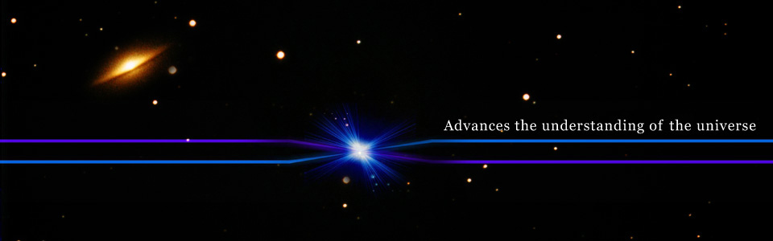

Slide 14
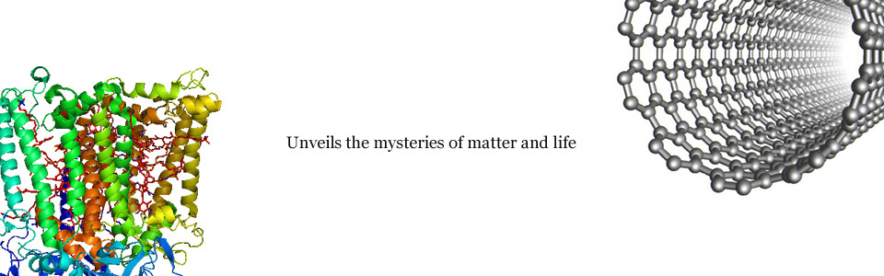

Slide 15
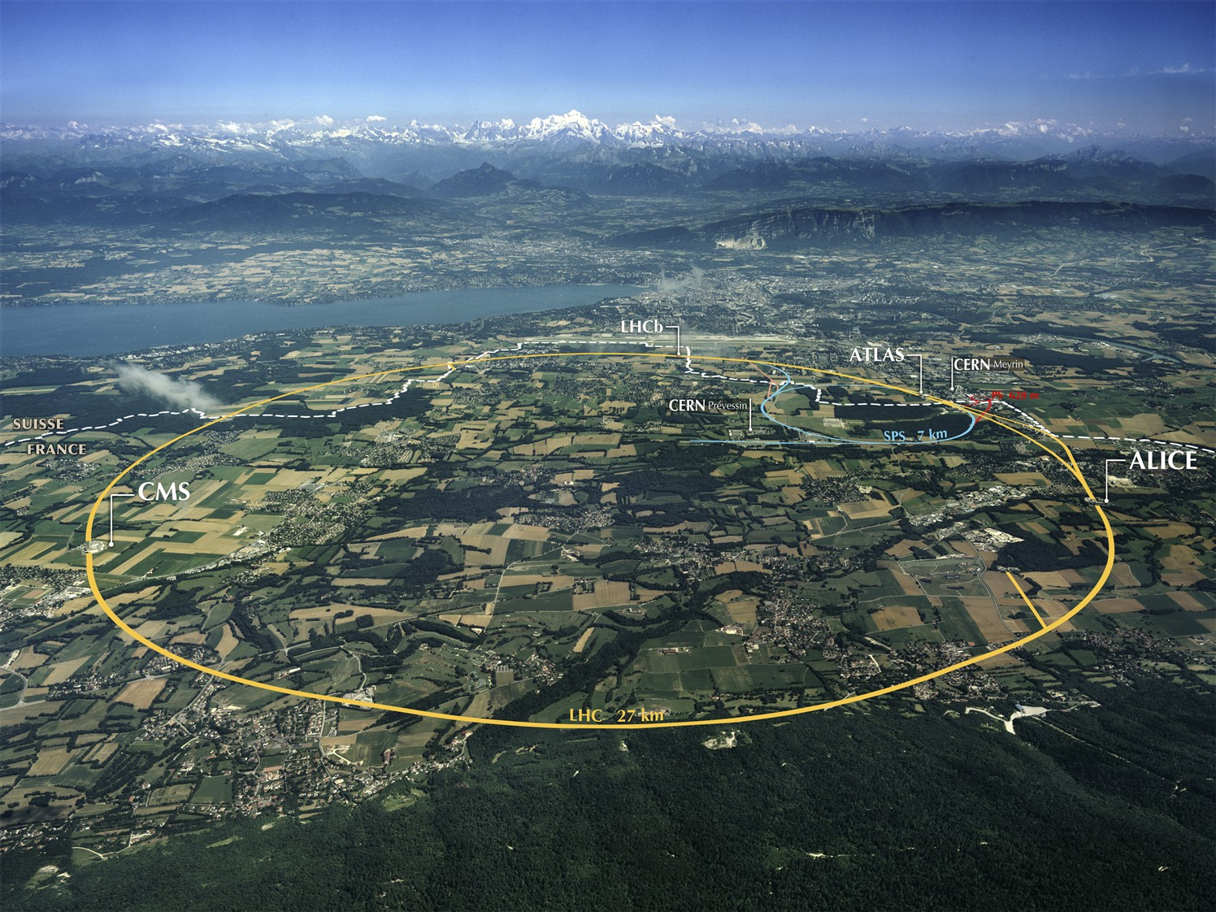

Slide 18
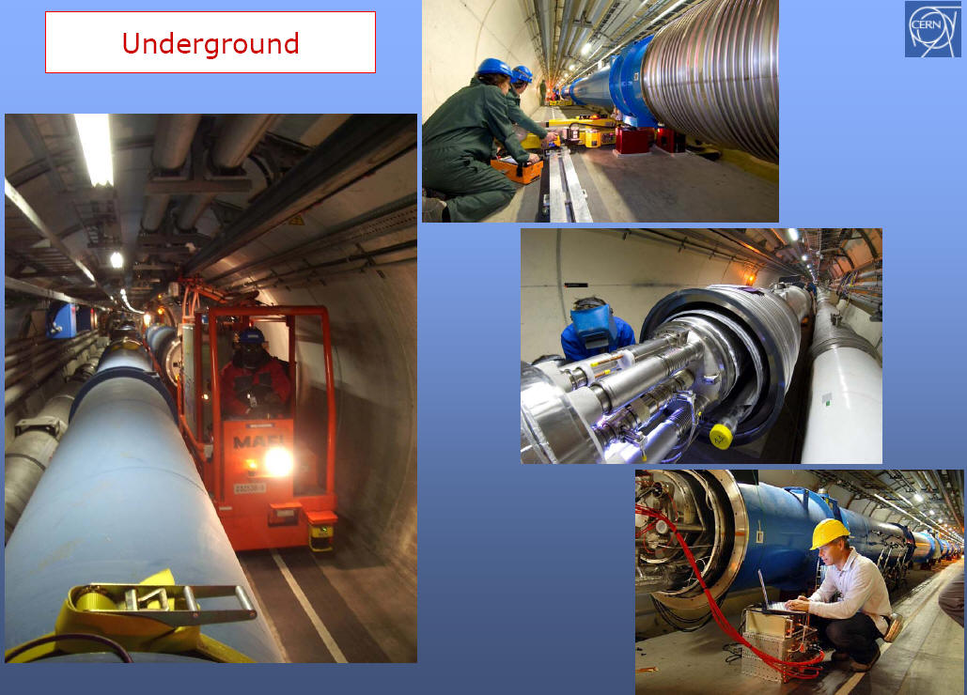

Slide 19
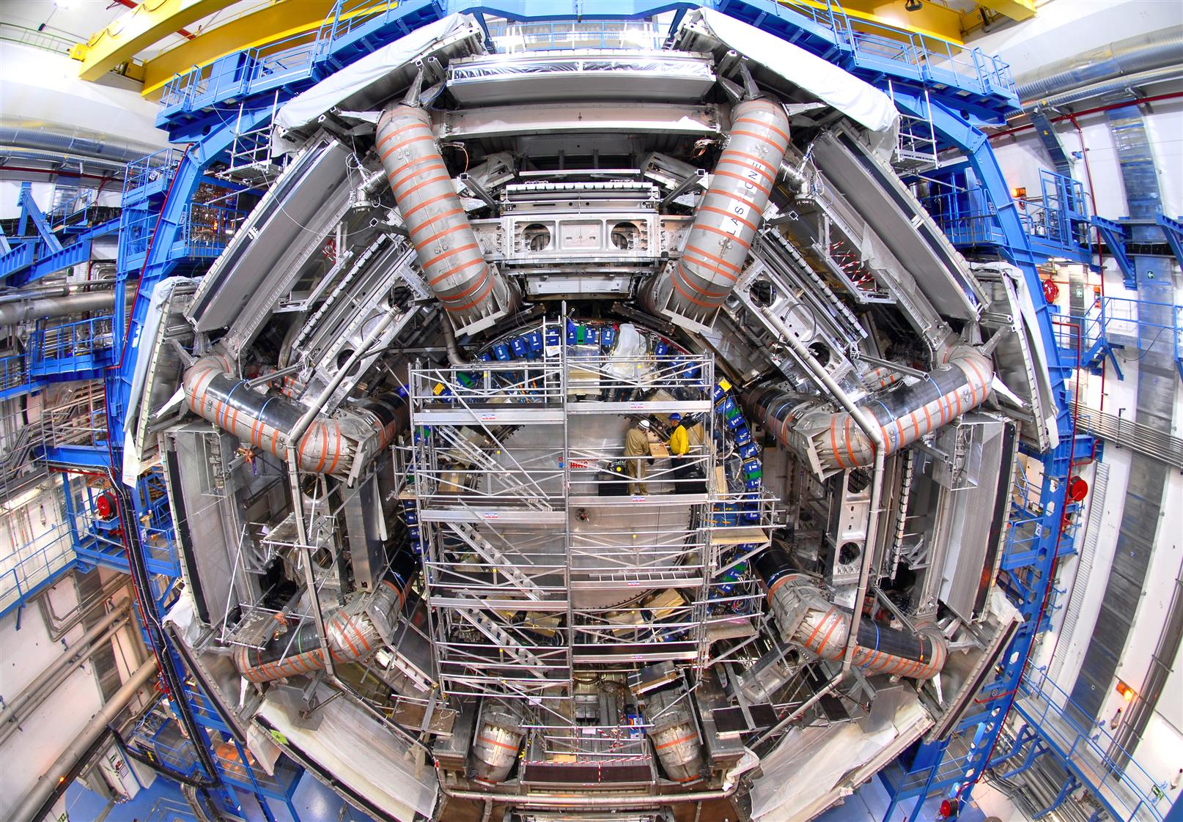

Slide 20
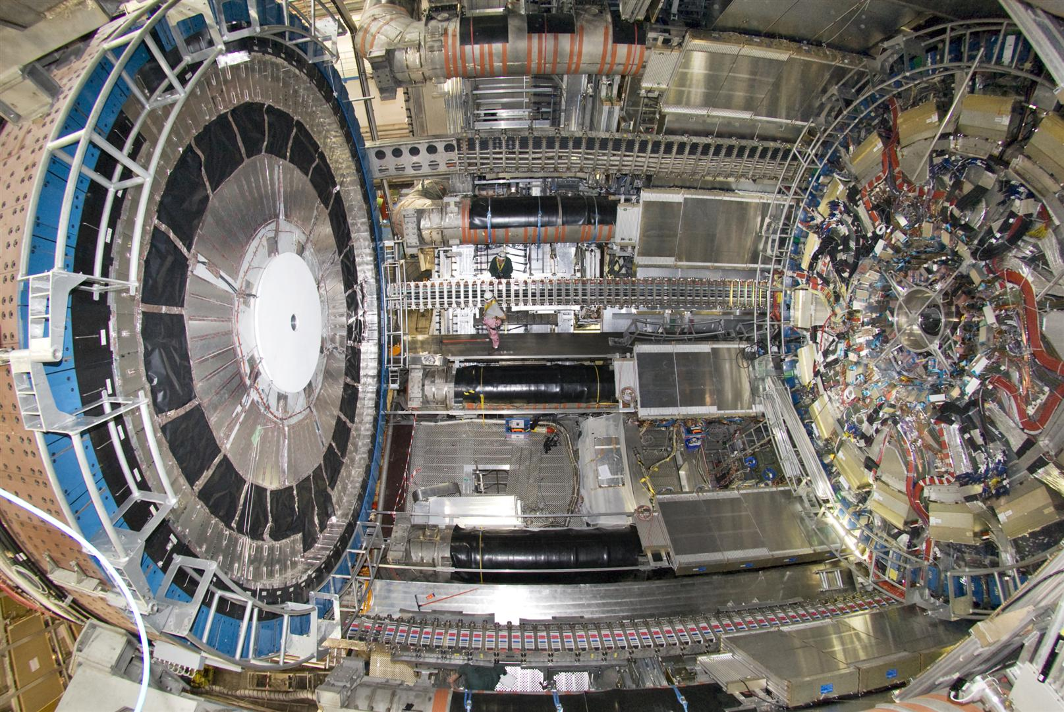

Slide 21
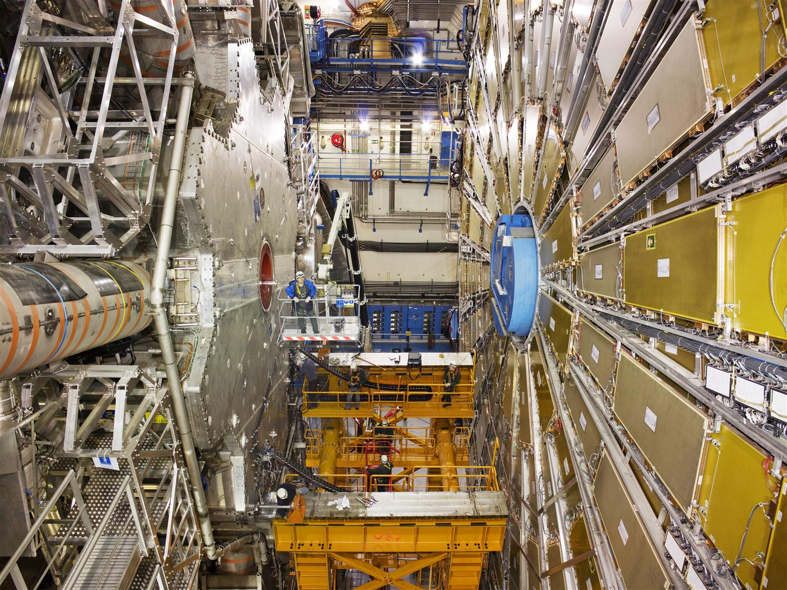

Slide 22
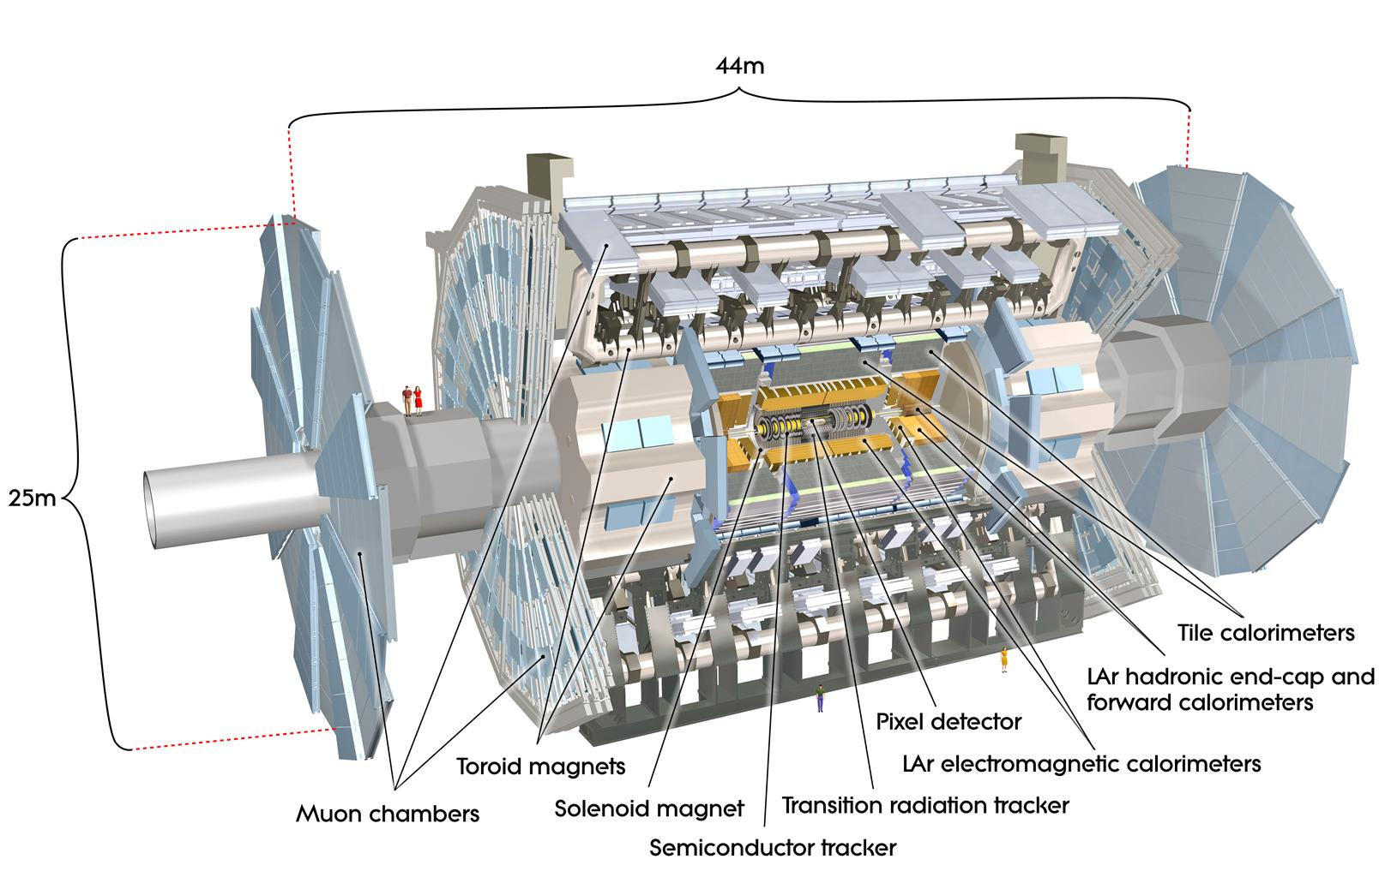

Slide 24
Why Higgs Boson?
Standard Model
QCD (Quantum Chromodynamics)
QED (Quantum Electrodynamics)
Force | Strength | Carrier | Physical effect
Strong nuclear | 1 | Gluons | Binds nuclei
Electromagnetic | .001 | Photon | Light, electricity
Weak nuclear | .00001 | Z⁰,W⁺,W⁻ | Radioactivity
Gravity | 10⁻³⁸ | Graviton? | Gravitation

Slide 26
Forces
Strong, weak, electromagnetic, gravity
Force carriers: gluon, W/Z bosons, photon
Gluon and photon are massless
W/Z are very heavy…..WHY?????
This is the question of symmetry breaking

Slide 27
Why is Mass a Problem?
Gauge Invariance is the guiding principle
Gauge Invariance leads to QED
  Predicts massless photons
Gauge Invariance leads to QCD
  Predicts massless gluons
Applying the same principle to weak interactions, predicts massless force carriers (i.e. W/Z)

Slide 28
The Solution: The Higgs Field
Screening Current
  Photons behave as if they have mass
  This idea could be responsible for the mass of force-field quanta
  The relationship between screening current and mass, and in the context of quantum field theory was developed by Peter Higgs (1964).

Slide 29
Higgs Field
We hypothesize that there is a background density of some field with which W and Z quanta interact (but not the massless photon).
The interaction of W⁺, W⁻, and Z with Higgs field leads to the screening effect and generates the effective masses of these particles.

Slide 30
Higgs Boson
In order to give a nonzero value to the background field, we need a Higgs potential.
Deviations from the uniform field values at different points in space-time, indicates the presence of quantum of this field, that is, the Higgs Boson.

Slide 32
Producing Higgs Bosons

Slide 33
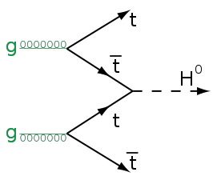
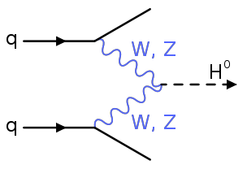
Producing Higgs Bosons

Slide 34



Gluon-gluon fusion

Slide 35




Slide 36
How to Discover Higgs
This is a tricky business!
  Lots of complicated statistical tools needed at some level
But in a nutshell:
  Need to show that we have a signal that is inconsistent with being background
  Need number of observed data events to be inconsistent with background fluctuation

Slide 37
Higgs Boson Decay

Slide 38
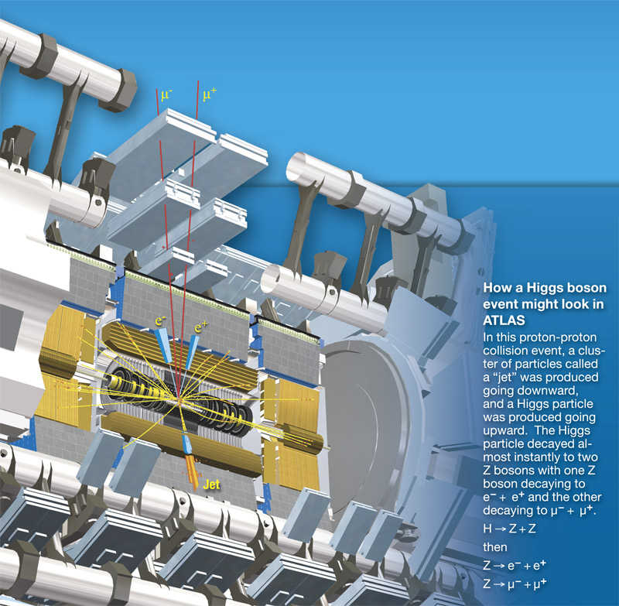

Slide 39
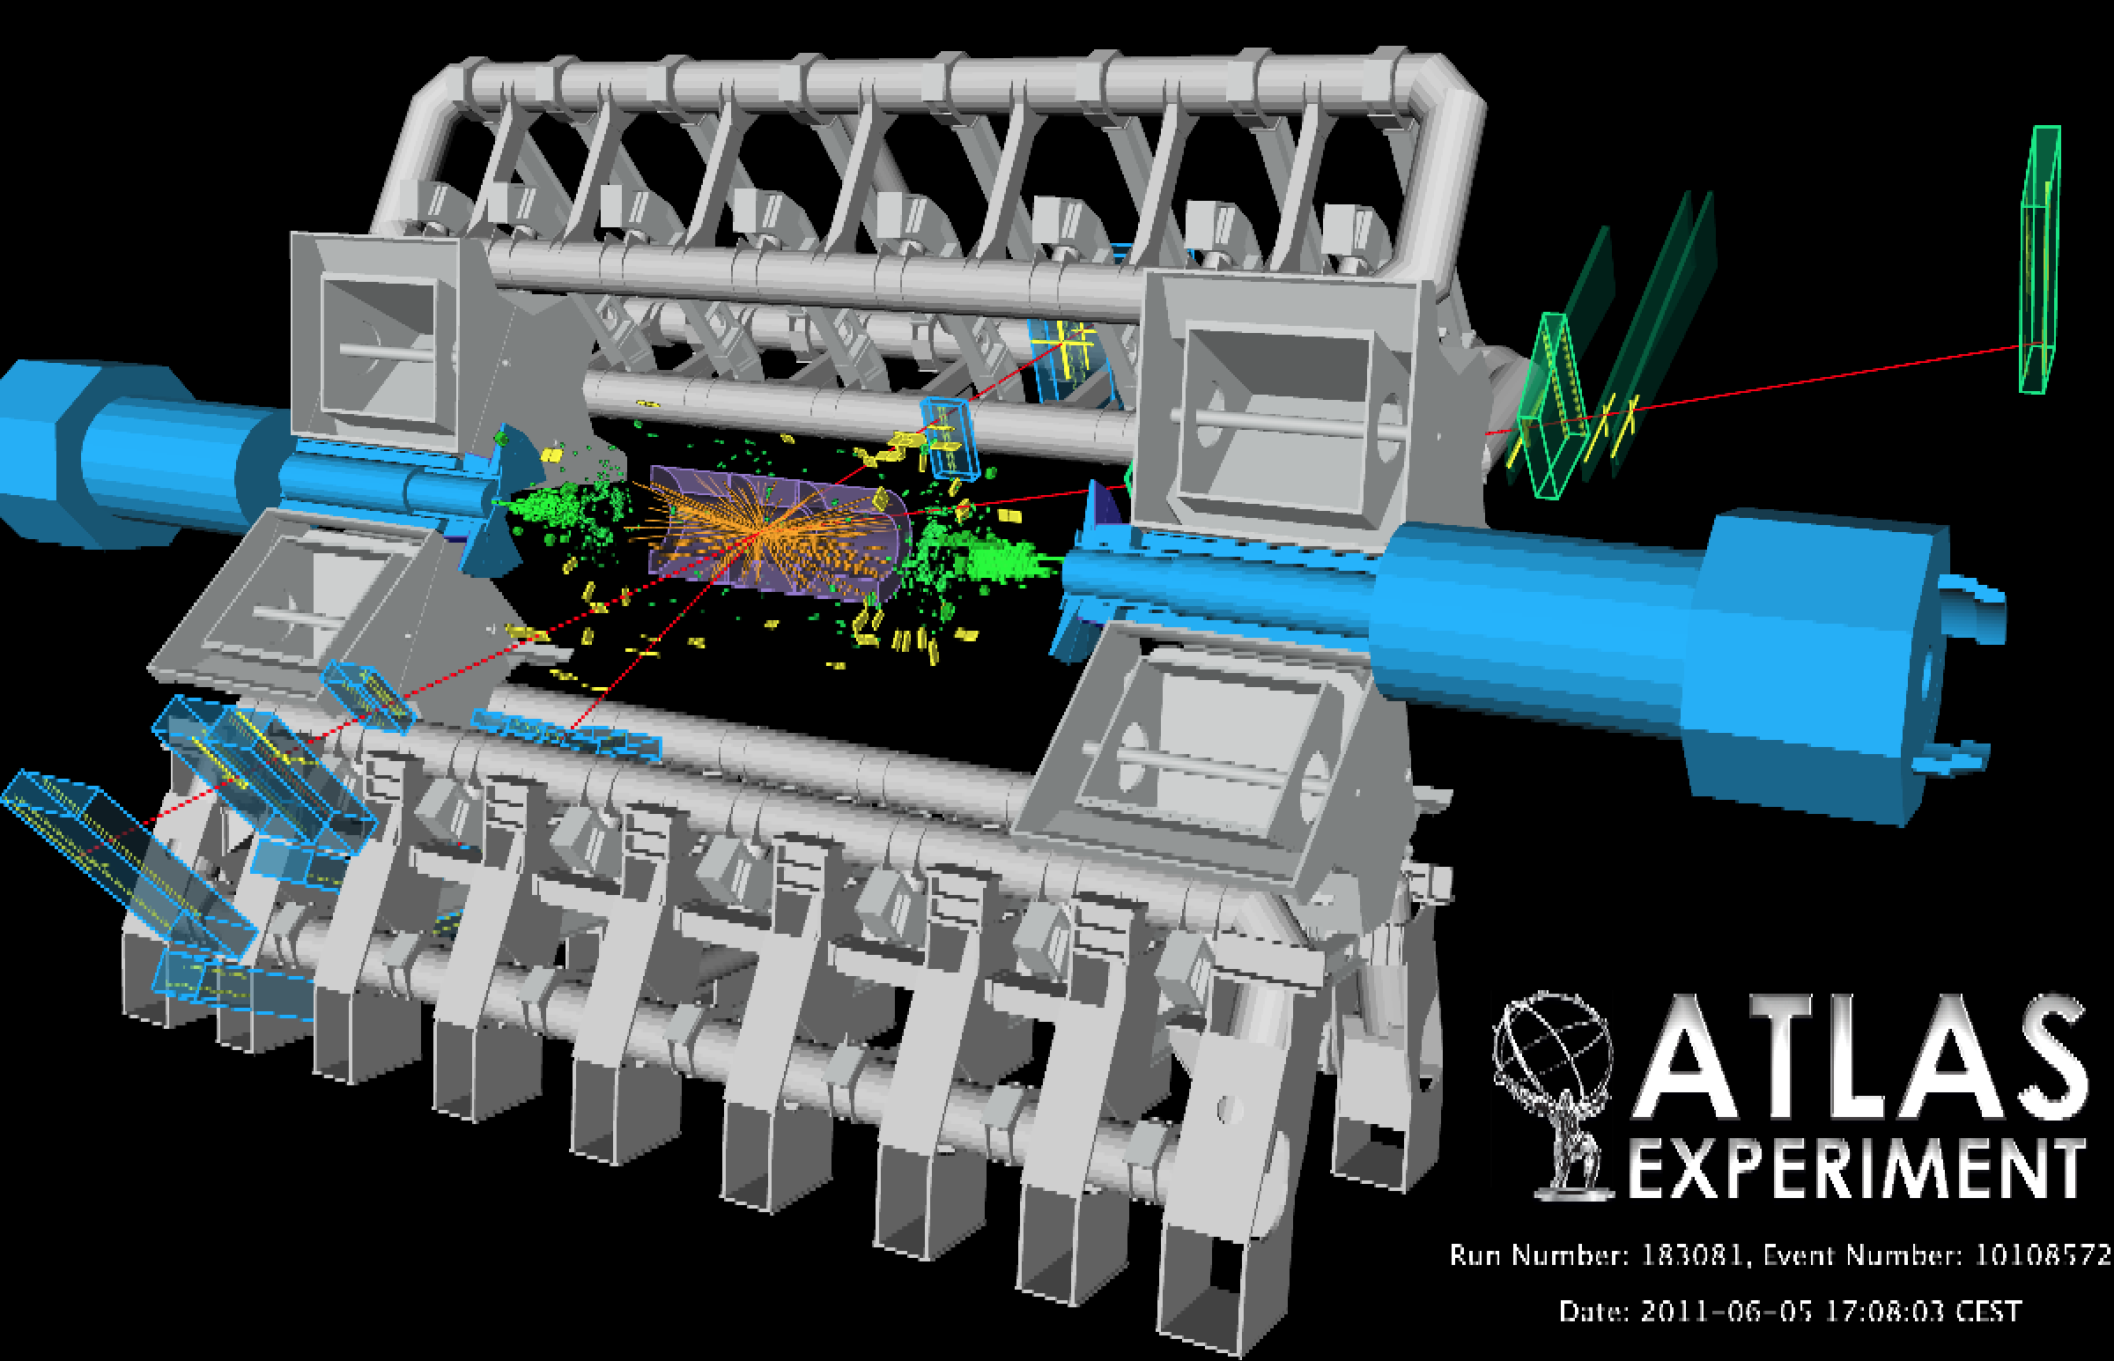

Slide 40
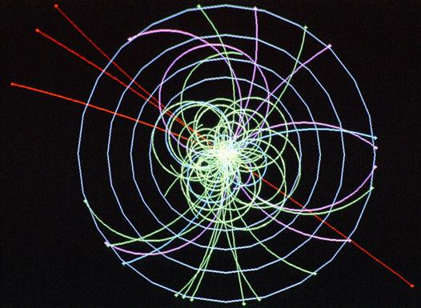
If a Higgs particle is produced in a proton-proton collision, an LHC detector might infer what you see here. The four straight red lines indicate very high-energy particles (muons) that are the remnants of the disintegrating Higgs.

Slide 41
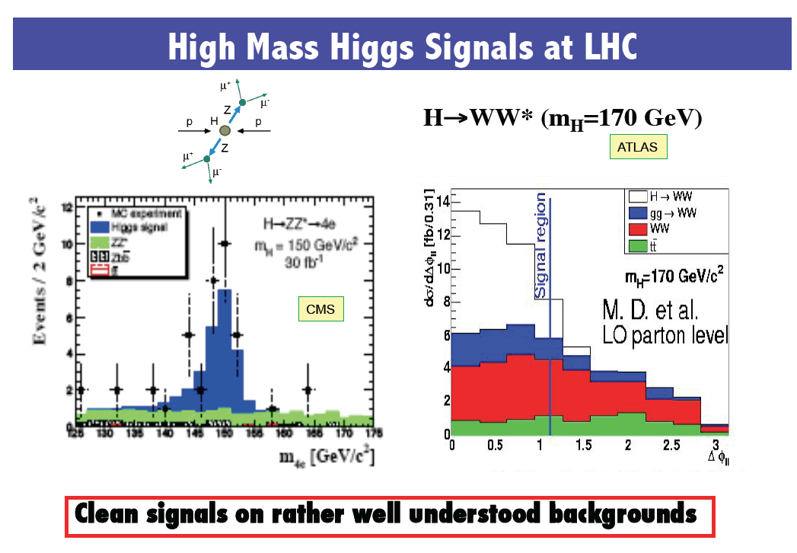

Slide 42
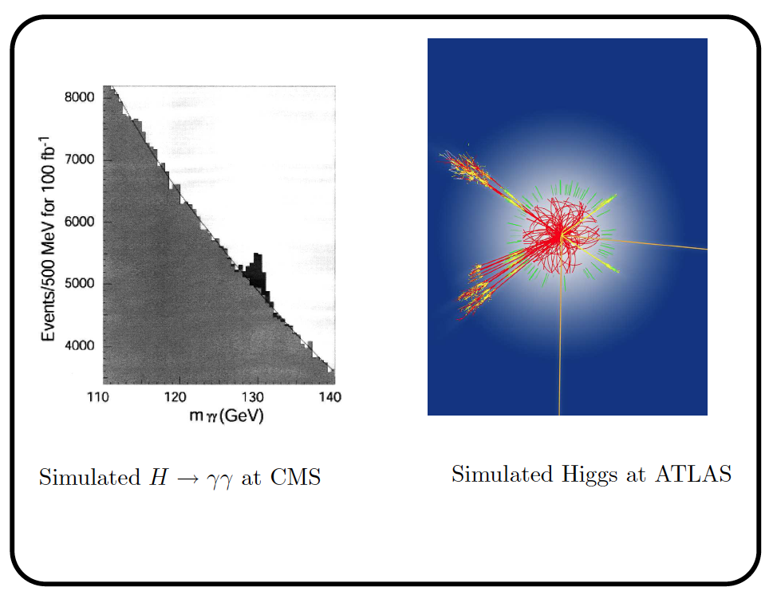

Slide 43
Status of Higgs Before LHC

Slide 44
ATLAS Results

Slide 47
Higgs Searches in ATLAS
The Higgs boson can decay into a variety of different particles
ATLAS currently covers nine different decay modes.
The latest data: 85% of all mass regions below 466 GeV are excluded at the 95% CL.
Higgs discovery is most likely: 115-146 GeV, 232-256 GeV, 282-296 GeV plus any mass above 466 GeV.

